Slide 1
Lecture 9
Synchronization

Slide 2
Concurrency in the Kernel
On symmetric multiprocessing (SMP) OS kernels are pre-emptible
True concurrency
Multiple processors execute instructions simultaneously
Pseudo concurrency
Instructions of multiple execution sequences are interleaved

Slide 3
Sources of pseudo concurrency
Software-based pre-emption
Voluntary preemption (sleep/yield)
Involuntary preemption (preemptable kernel)
Scheduler switches threads regardless of whether they are running in user or kernel mode
Solutions: don’t do the former, disable preemption to prevent the latter
Hardware pre-emption
Interrupt/trap/fault/exception handlers can start executing at any time
Solution: disable interrupts

Slide 4
Kernel Control Paths
Interrupt handlers
Exception handlers
User-space threads in kernel(system calls)
Kernel threads(idle, work queue, pdflush…)
Bottom halves(soft irq, tasklet,BH...)
Note: Something like the memory allocator is not a KCP. It is called in a KCP.

Slide 5
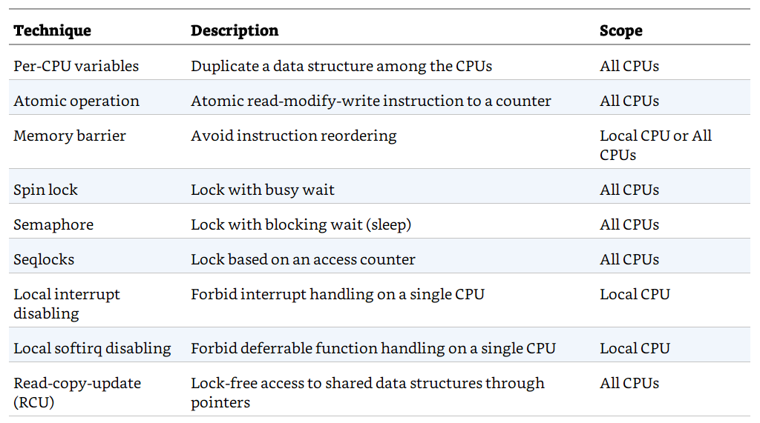
Synchronization techniques in Linux

Slide 6
Per-CPU Variables

Slide 7
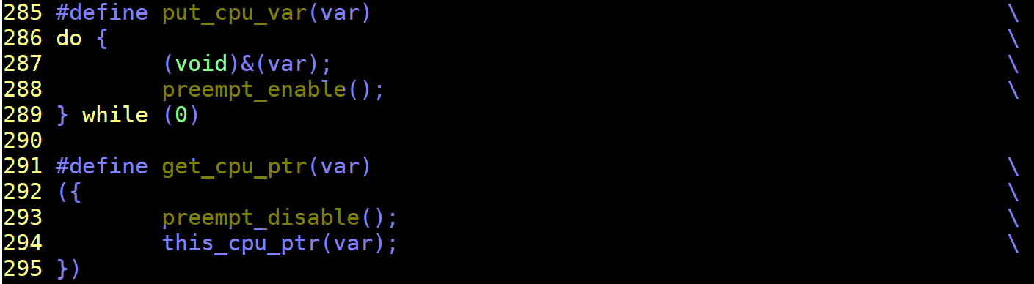
Per-CPU variables
One variable per CPU
Reduce need to synchronize across CPUs
Additional protection may be needed
Example: a kernel control path gets the address of its local copy of a per-CPU variable, and then it is preempted and moved to another CPU: the address still refers to the element of the previous CPU.
Control preemption before performing read or write.
include/linux/percpu-defs.h

Slide 8
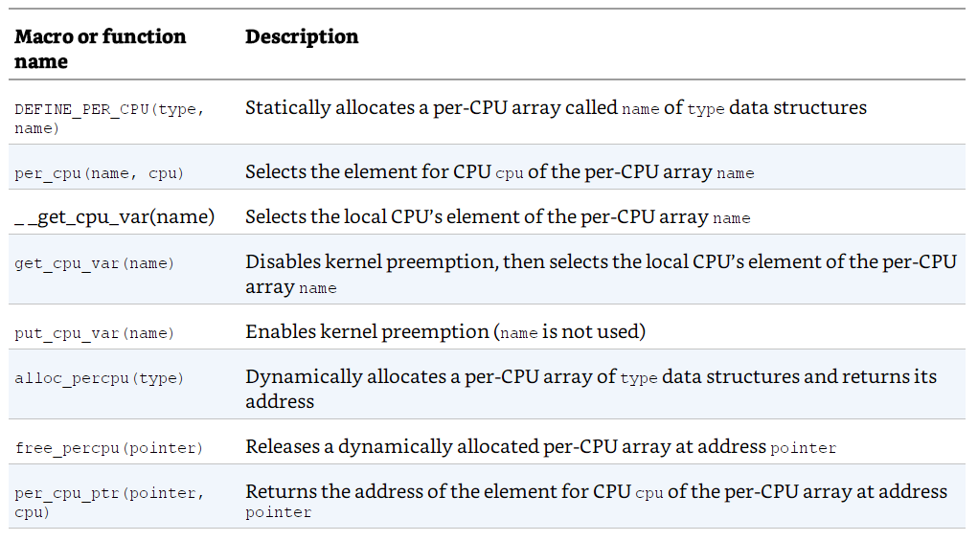
Linux per-CPU variables

Slide 9
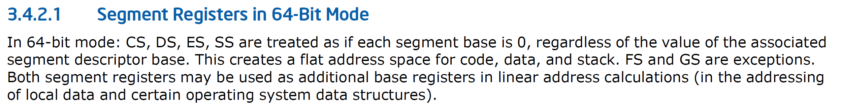
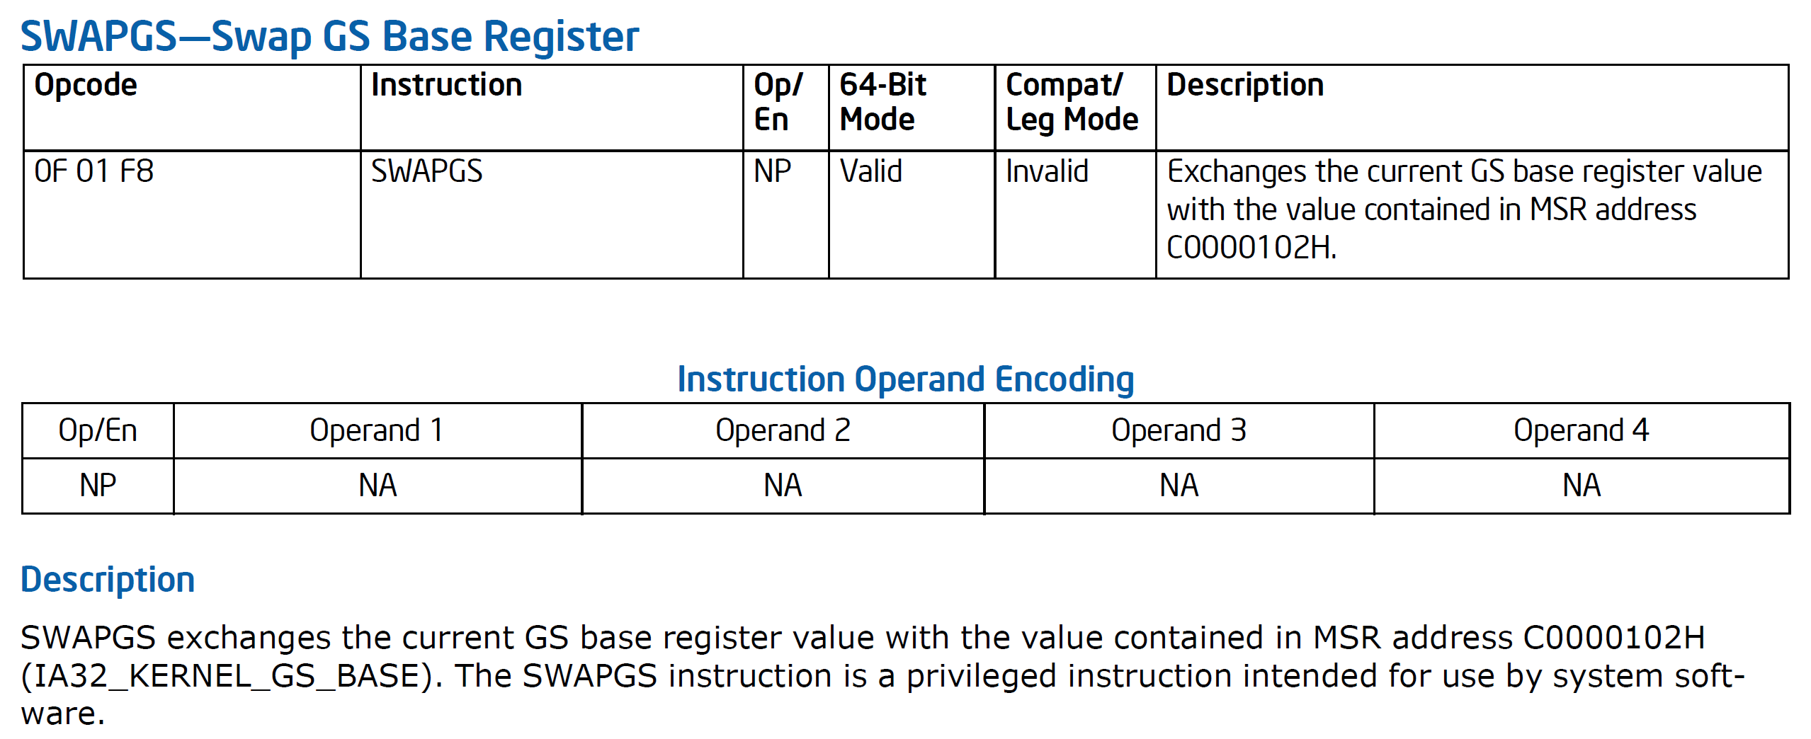
Per-CPU variables implementation in x86-64
From the Intel manual:

Slide 10
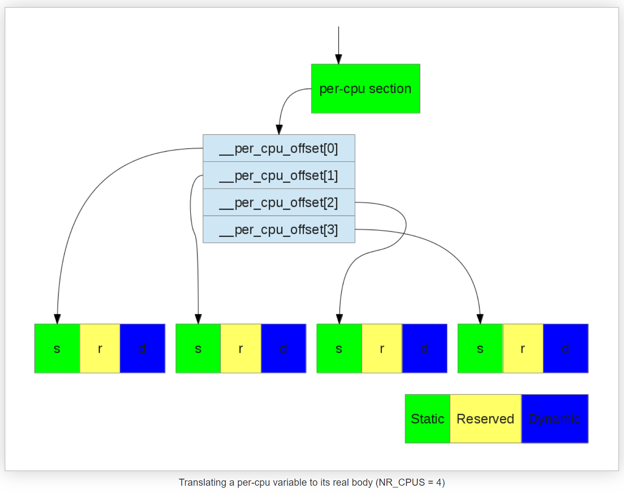
Per-CPU on x86-64
User mode
GS register:
Kernel mode
SWAPGS
GS register:
0
Source: http://thinkiii.blogspot.com/2014/05/a-brief-introduction-to-per-cpu.html

Slide 11
Atomic Operations

Slide 12
Atomic operators
Simplest synchronization primitives
Primitive operations that are indivisible
Two types
methods that operate on integers
methods that operate on bits
Implementation
Assembly language sequences that use the atomic read-modify-write instructions of the underlying CPU architecture

Slide 13
Atomic integer operators
atomic_t v;
atomic_set(&v, 5); /* v = 5 (atomically) */
atomic_add(3, &v); /* v = v + 3 (atomically) */
atomic_dec(&v); /* v = v - 1 (atomically) */
printf("This will print 7: %d\n", atomic_read(&v));
Beware:
Can only pass atomic_t to an atomic operator
atomic_add(3,&v); and { atomic_add(1,&v); atomic_add(2,&v); } are not the same! … Why?

Slide 14
Memory Barriers

Slide 15
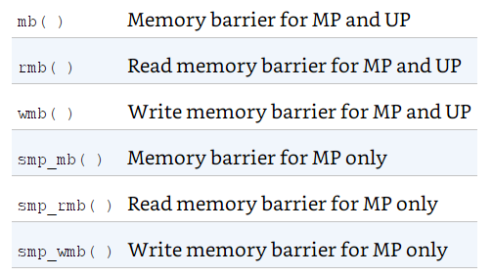
Barriers
Compilers can reorder the sequence of instructions
Superscalar processors may reorder reads and writes
Optimization barrier
barrier()
Instruction to compiler: C statements before and after barrier are not to be mixed
Memory barrier
Machine instructions issued to processor to explicitly prevent memory read-write reordering

Slide 16
Spin Locks

Slide 17
Spin locks
Mutual exclusion for larger (than one operator) critical sections requires additional support
Spin locks are one possibility
Single holder locks
When lock is unavailable, the acquiring process keeps trying

Slide 18
Basic use of spin locks
spinlock_t mr_lock = SPIN_LOCK_UNLOCKED;
spin_lock(&mr_lock); /* critical section ... */
spin_unlock(&mr_lock);
spin_lock()
Acquires the spinlock using atomic instructions required for SMP
spin_unlock()
Releases the spinlock

Slide 19
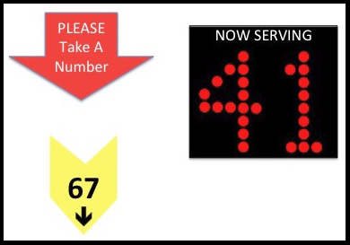
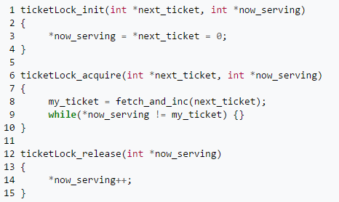
Ticket locks
Spin locks in Linux implemented by ticket locks
FIFO fairness
Atomic operations!

Slide 20
An Issue
Interrupting a spin lock holder may cause several problems:
Spin lock holder is delayed, so is every thread spin waiting for the spin lock
Not a big problem if interrupt handlers are short
Interrupt handler may access the data protected by the spin-lock
Should the interrupt handler use the lock?
Can it be delayed trying to acquire a spin lock?
What if the lock is already held by the thread it interrupted?

Slide 21
Solutions
If data is only accessed in interrupt context and is local to one specific CPU we can use interrupt disabling to synchronize
If data is accessed from other CPUs we need additional synchronization
Spin locks
Spin locks can not be acquired in interrupt context because this might deadlock
Normal code (kernel context) must disable interrupts and acquire spin lock
interrupt context code need not acquire spin lock
assumes data is not accessed by interrupt handlers on different CPUs, i.e., interrupts are CPU-local and this is CPU-local data

Slide 22
Combining spin locks and interrupt disabling
Non-interrupt code acquires spin lock to synchronize with other non-interrupt code and disables interrupts to synchronize with local invocations of the interrupt handler

Slide 23
Combining spin locks and interrupt disabling
spinlock_t mr_lock = SPIN_LOCK_UNLOCKED;
unsigned long flags;
spin_lock_irqsave(&mr_lock, flags); /* critical section ... */
spin_unlock_irqrestore(&mr_lock, flags);
spin_lock_irqsave()
disables interrupts locally
acquires the spinlock using instructions required for SMP
spin_unlock_irqrestore()
Restores interrupts to the state they were in when the lock was acquired

Slide 24
Bottom halves and softirqs
Softirqs, tasklets and BHs are deferrable functions
delayed interrupt handling work that is scheduled
they can wait for a spin lock without holding up devices
they can access non-CPU local data
Softirqs – the basic building block
statically allocated and non-preemptively scheduled
can not be interrupted by another softirq on the same CPU
can run concurrently on different CPUs, and synchronize with each other using spin-locks
Bottom Halves
built on softirqs
can not run concurrently on different CPUs

Slide 25
Spin locks and deferred functions
spin_lock_bh()
implements the standard spinlock
disables softirqs
needed for code outside a softirq that manipulates data also used inside a softirq
Allows the softirq to use non-preemption only
spin_unlock_bh()
Releases the spinlock
Enables softirqs

Slide 26
Spin lock rules
Do not try to re-acquire a spinlock you already hold!
It leads to self deadlock!
Spinlocks should not be held for a long time
Excessive spinning wastes CPU cycles!
What is “a long time”?
Do not sleep while holding a spinlock!
Someone spinning waiting for you will waste a lot of CPU
never call any function that touches user memory, allocates memory, calls a semaphore function or any of the schedule functions while holding a spinlock! All these can block.

Slide 27
Semaphores

Slide 28
Semaphores
Semaphores are locks that are safe to hold for longer periods of time
Contention for semaphores causes blocking not spinning
Should not be used for short duration critical sections
Semaphores are safe to sleep with!
Can be used to synchronize with user contexts that might block or be preempted
Semaphores can allow concurrency for more than one process at a time, if necessary
i.e., initialize to a value greater than 1

Slide 29
Semaphore implementation
Implemented as a wait queue and a usage count
Wait queue: list of processes blocking on the semaphore
Usage count: number of concurrently allowed holders
if negative, the semaphore is unavailable, and
absolute value of usage count is the number of processes currently on the wait queue
initialize to 1 to use the semaphore as a mutex lock

Slide 30
Semaphore operations
Down()
attempts to acquire the semaphore by decrementing the usage count and testing if its negative
blocks if usage count is negative
Up()
releases the semaphore by incrementing the usage count and waking up one or more tasks blocked on it

Slide 31
Can you be interrupted when blocked?
down_interruptible()
Returns –EINTR if signal received while blocked
Returns 0 on success
down_trylock()
attempts to acquire the semaphore
on failure it returns nonzero instead of blocking

Slide 32
Reader-writer Spinlocks

Slide 33
Reader/writer Locks
No need to synchronize concurrent readers unless a writer is present
reader/writer locks allow multiple concurrent readers but only a single writer (with no concurrent readers)
Both spin locks and semaphores have reader/writer variants

Slide 34
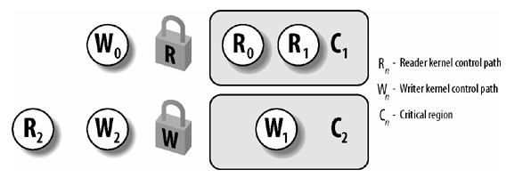
Reader/writer spin locks (rwlock)
rwlock_t mr_rwlock = RW_LOCK_UNLOCKED;
read_lock(&mr_rwlock);
/* critical section (read only) ... */
read_unlock(&mr_rwlock);
write_lock(&mr_rwlock);
/* critical section (read and write) ... */
write_unlock(&mr_rwlock);

Slide 35
Reader/writer lock warnings
Reader locks cannot be automatically upgraded to the writer variant
Attempting to acquire exclusive access while holding reader access will deadlock!
If you know you will need to write eventually
Obtain the writer variant of the lock from the beginning
Or, release the reader lock and re-acquire the lock as a writer
But bear in mind that memory may have changed when you get in!

Slide 36
Reader/writer semaphores (rw_semaphore)
struct rw_semaphore mr_rwsem;
init_rwsem(&mr_rwsem);
down_read(&mr_rwsem); /* critical region (read only) ... */
up_read(&mr_rwsem);
down_write(&mr_rwsem); /* critical region (read and write) ... */
up_write(&mr_rwsem);

Slide 37
Big reader locks (br_lock)
Specialized form of reader/writer lock
Very fast to acquire for reading
Very slow to acquire for writing
Good for read-mostly scenarios
Implemented using per-CPU locks
Readers acquire their own CPU’s lock
Writers must acquire all CPUs’ locks

Slide 38
Seqlocks

Slide 39
Seqlock
Introduced in Linux 2.6
Similar to Read-Write Locks but writers get much higher priority
Pros:
Writer almost never waits (unless more than one writer)
Cons:
Readers have to retry

Slide 40
Seqlock Data Structure
Two fields:
A spin lock lock
An integer sequence field
Reader must read the sequence field twice (before and after reading the data)
Spinlock not used!
do {
seq = read_seqbegin(&seqlock);
...
} while (read_seqretry(&seqlock, seq));

Slide 41
Seqlock writer
Writer must
Acquire spinlock and increase the sequence field (in write_seqlock())
Do its write
Increase the sequence field once more then release spinlock (in write_sequnlock())
Hence, before and after write, sequence field is even
True if sequence is odd or
the two sequences don’t match
do {
seq = read_seqbegin(&seqlock);
...
} while (read_seqretry(&seqlock, seq));

Slide 42
Conditions for using seqlocks
The data structure to be protected does not include pointers that are modified by the writers and dereferenced by the readers
Otherwise, a writer could change the pointer under the nose of the readers
The code in the critical regions of the readers does not have side effects
Otherwise, multiple reads would have different effects from a single read

Slide 43
Big Kernel Lock
(Not in use anymore)

Slide 44
Big kernel lock (BKL)
A global kernel lock - kernel_flag
Used to be the only SMP lock
Removed since 2.6.39
Replaced with fine-grain localized locks
Linux distributions at or above CentOS 7, Debian 7 (Wheezy) and Ubuntu 11.10 not longer use BKL.

Slide 45
Preemptible kernel issues
Have to be careful of legacy code that assumes per-CPU data is implicitly protected from preemption
Legacy code assumes “non-preemption in kernel mode”
May need to use new preempt_disable() and preempt_enable() calls
Calls are nestable
for each n preempt_disable() calls, preemption will not be re-enabled until the nth preempt_enable() call

Slide 46
Read-copy Update

Slide 47
Read-Copy Update (RCU)
Designed for multi CPU operation
Allows many readers and many writers to proceed concurrently
RCU is lock free
Only data structures that are dynamically allocated and referenced by means of pointers can be protected by RCU
No kernel control path can sleep inside a critical region protected by RCU

Slide 48
RCU Read
rcu_read_lock() is just preempt_disable()
Dereference a pointer and read
rcu_write_lock() is just preempt_enable()
Real work done by writers

Slide 49
RCU Writes
Writer makes a copy of data structure by dereferencing the pointer
All changes made strictly to the copy, never to the source
Once finished, writer changes the pointer to the data structure atomically
So readers only see old or new copy of data structure but not both
We have a new problem: when can we free the old data structure?

Slide 50
Everyone must cooperate
The kernel requires every potential reader to execute rcu_read_unlock() before:
The CPU performs a process switch
The CPU starts executing in User Mode
The CPU executes the idle loop
RCU introduced in Linux 2.6 and used in the networking layer and in the Virtual File System

Slide 51
Completion
Introduced in Linux 2.6
Solves a problem with semaphores
up() and down() can be done in parallel
A process can destroy a semaphore while some other process (say in another CPU) is in the middle of an operation
complete() replaces up()
wait_for_completion() replaces down()
Spinlock is used to ensure that the two cannot be done concurrently

Slide 52
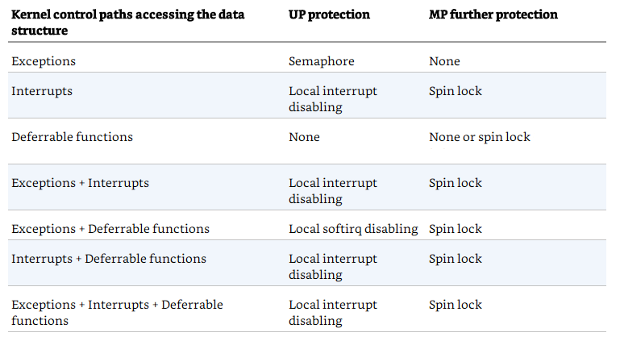
Choice of Protection

Slide 53
End

